Slide 1
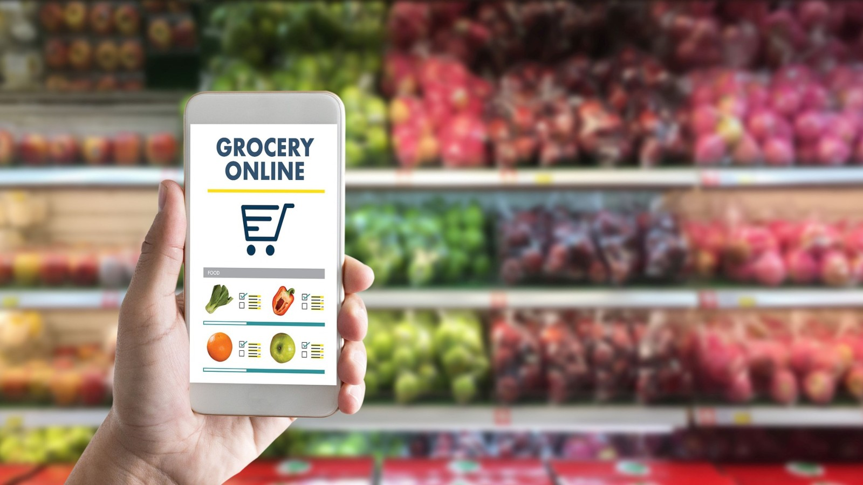
Grocery Delivery Application
Presented By –
Divya Gaikwad
Bhumika Waghmale
Kajal Kumbhar
Trupti Kawale
Shweta Shelke
Under the Guidence of –
Mrs.Pooja Mehta

Slide 2
INTRODUCTION
This project is a web based shopping system for an existing shop. The project objective is to deliver the online Grocery shopping application into web platform. Online Grocery shopping is the process whereby consumers directly buy goods or services from a seller in real-time, without an intermediary service, over the Internet. It is a form of electronic commerce.
This project is an attempt to provide the advantages of online Grocery shopping to customers of a real shop. It helps buying the products in the shop anywhere through internet by using an android device. Thus the customer will get the service of online Grocery shopping and home delivery from his favorite shop.
It will help to save the time and Give you best Quality and Quantity with assureity.

Slide 3
PROPOSED SYSTEM
In the proposed system customer need not go to the shop for buying the products.
He can order the product he wish to buy through the application in his Smartphone.
The shop owner will be admin of the system.
Shop owner can appoint moderators who will help owner in managing the customers and product orders.
The system also recommends a home delivery system for the purchased products.

Slide 4
SYSTEM ANALYSIS
System analysis is the process of gathering and interpreting facts, diagnosing problems and using the information to recommend improvements on the system.
System analysis is a problem solving activity that requires intensive communication between the system users and system developers. System analysis or study is an important phase of any system development process.
The system is viewed as a whole, the inputs are identified and the system is subjected to close study to identify the problem areas.
The solutions are given as a proposal. The proposal is reviewed on user request and suitable changes are made. This loop ends as soon as the user is satisfied with the proposal.

Slide 5
SYSTEM SPECIFICATION
SOFTWARE REQUIREMENTS :
Technology : JAVA
Business Layer : SpringBoot , Spring Framework, RestAPI , JPA, Hibernate,
Frontend Technology : HTML, CSS, Bootstrap4, Angular
Source Code Editor : Visual Code Studio
Database : MySQL
Testing Tool : Postman

Slide 6
HARDWARE REQUIREMENTS :
Intel Core i3 (Processor)
256 MB Ram
512 KB Cache Memory
Hard disk 10 GB (OPTIONAL)

Slide 7
TECHNOLOGIES
Spring Framework :
Spring Framework is a Java platform that provides comprehensive infrastructure support for developing Java applications. Spring handles the infrastructure so you can focus on your application.
Spring enables you to build applications from “plain old Java objects” (POJOs) and to apply enterprise services non-invasively to POJOs.
This capability applies to the Java SE programming model and to full and partial Java EE.

Slide 8
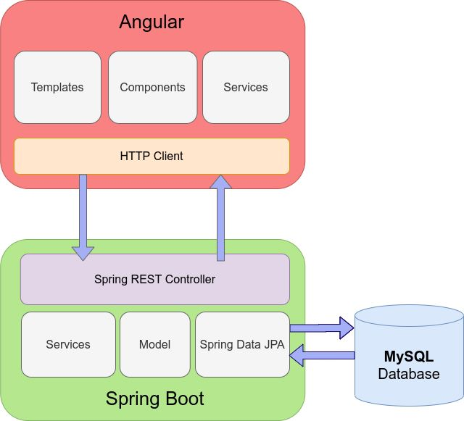
Spring Framework Architecture :

Slide 9
Bootstrap Framework :
Bootstrap is a free, open source front-end development framework for the creation of websites and web apps.
Bootstrap makes responsive web design a reality. It makes it possible for a web page or app to detect the visitor's screen size and orientation and automatically adapt the display accordingly.
The Bootstrap framework is built on Hypertext Markup Language (HTML), cascading style sheets (CSS) and JavaScript.

Slide 10
Angular Framework :
Angular is a platform and framework for building single-page client applications using HTML and TypeScript. Angular is written in TypeScript.
It implements core and optional functionality as a set of TypeScript libraries that you import into your applications.
Java script is the most commonly used client-side scripting language. It is written into HTML documents to enable interactions with web pages in many unique ways.
As a relatively easy-to-learn language with pervasive support, it is well-suited to develop modern applications.

Slide 11
Hibernate Framework :
Hibernate is an open source object relational mapping (ORM) tool that provides a framework to map object-oriented domain models to relational databases for web applications. Hibernate is an open source Object-Relational Persistence and Query service for any Java Application.
Hibernate maps Java classes to database tables and from Java data types to SQL data types and relieves the developer from most common data persistence related programming tasks.

Slide 12
MySQL :
MySQL is a relational database management system (RDBMS) developed by Oracle that is based on structured query language (SQL).
A database is a structured collection of data. It may be anything from a simple shopping list to a picture gallery or a place to hold the vast amounts of information in a corporate network.
It is used to add, access, and process data stored in a computer database.

Slide 13
ANNOTATIONS
@Entity : It defines that a class can be mapped to a table
@Id : It defines the simplest mechanism to define the mapping to the primary key.
@Generatedvalue : It provides for specification of generation strategies for values of primary keys.
@table : It allows you to specify details of table that will be used to persist the entity in the database.
@column : It is used for Adding the column the name in the table of a particular MySQL database.
@onetoone : It defines a single-valued association to another entity that has one-to-one multiplicity.
@onetomany : It used to define property in Item class that will be used to map mappedBy variable.

Slide 14
@manytomany : It is used in both classes to create the many-to-many relationship between the entities.
@controller : It indicates that a particular class serves the role of a controller.
@Restcontroller : It is used to create RESTful web services using Spring MVC.
@requestmapping : It is used to map web requests onto specific handler classes and/or handler methods.
@Autowired : It is used for automatic dependency injection.
@service : It is used to indicate that a class belongs to that layer.
@overriding : It informs the compiler that element is meant to override an element declared in a superclass.

Slide 15
COMPONENTS
Components are the most basic UI building block of an Angular app. An Angular app contains a tree of Angular components. Angular components are a subset of directives, always associated with a template.
Used components :
Home , About Us , Contact Us ,Client Login , Admin Login
Home ,Cart List , Order ,Logout

Slide 16
Structure of Components in Angular :
Module.ts : This is the main module file for the project . Each angular project is divided into modules to make the project management easy.
Component.html : This file is used to make changes to the page. You can edit this file as an html file.
Component.spec.ts : This are automatically generated files which contain unit tests for source component.
Component.ts : It helps to do the processing of the html structure in the .ts file. The processing will include activities such as connecting to the database interacting with other components , routing, services etc.
Component.css : Here you can add css for your component.

Slide 17
SCOPE OF SYSTEM
This system can be implemented to any shop in the locality or to multinational branded shops having retail outlet chains.
The system recommends a facility to accept the orders 24*7 and a home delivery system which can make customers happy.
If shops are providing an online portal where their customers can enjoy easy shopping from anywhere, the shops won’t be losing any more customers to the trending online shops such as flipcart or amazon .
Since the application is available in the Smartphone it is easily accessible and always available.

Slide 18
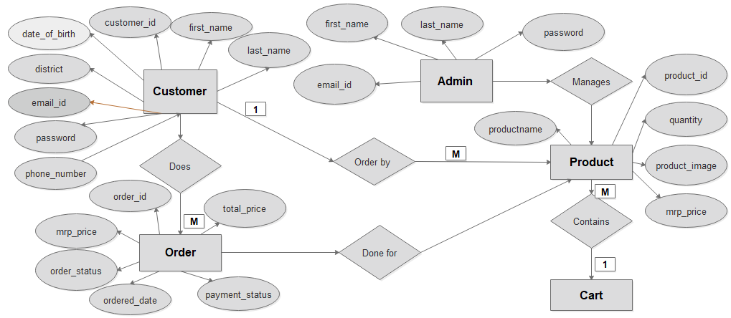
ER DIAGRAM

Slide 19
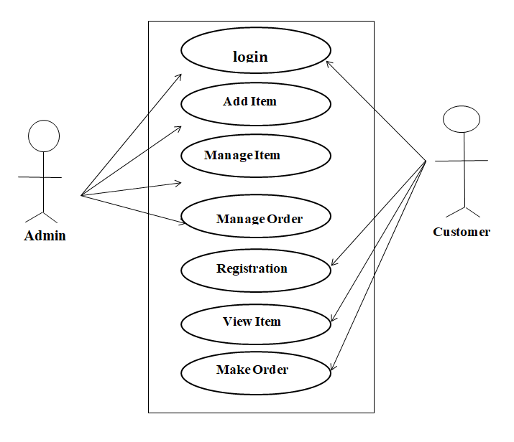
USECASE DIAGRAM

Slide 20
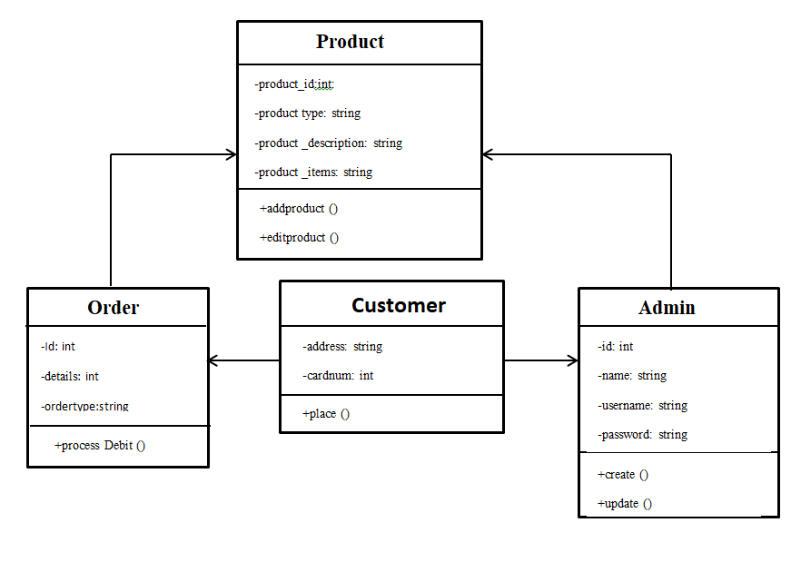
CLASS DIAGRAM

Slide 21
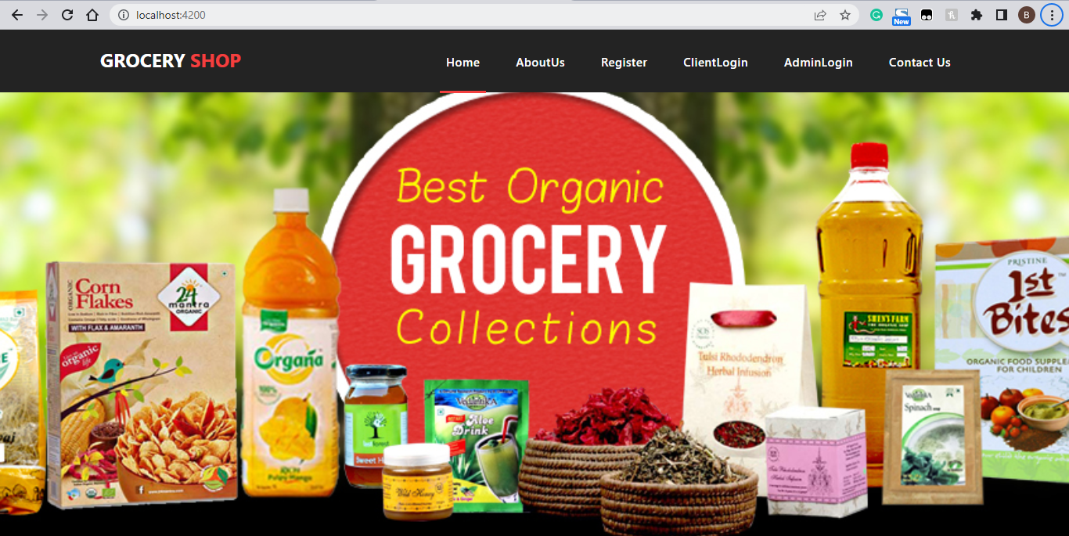
System Design and Implementation
1)Home Page

Slide 22
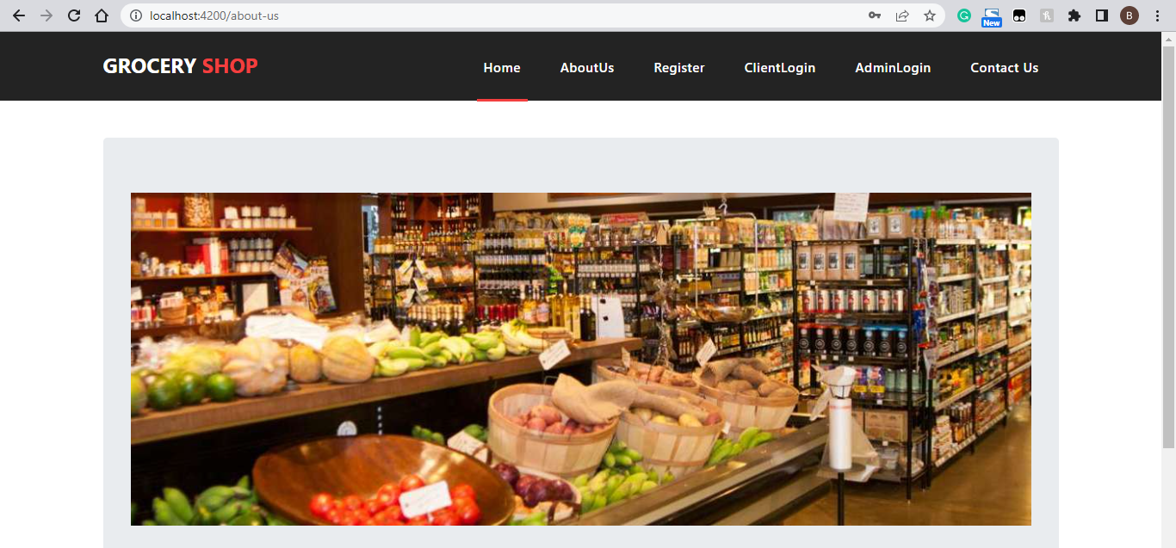
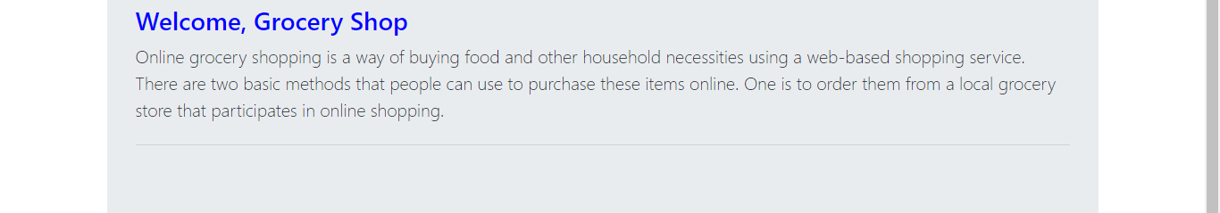
2) About Us Page

Slide 23
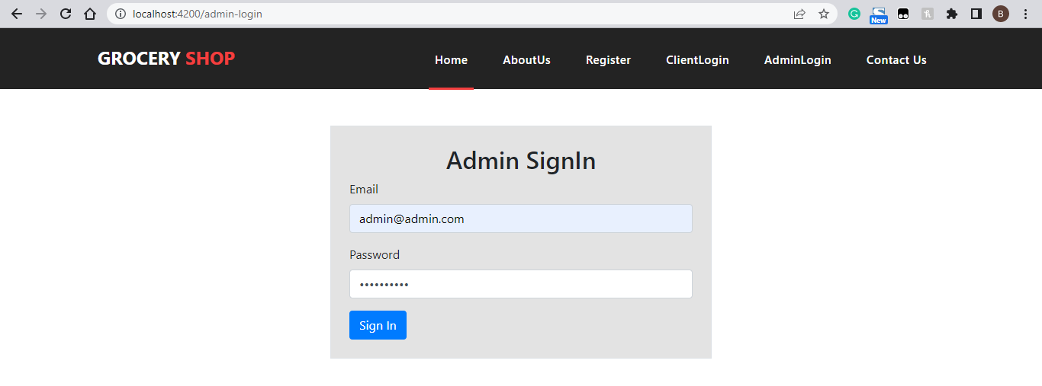
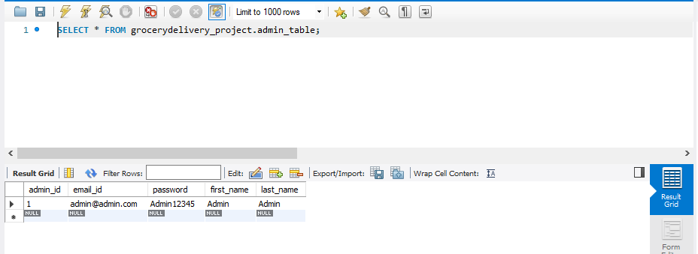
3)Admin Login

Slide 24
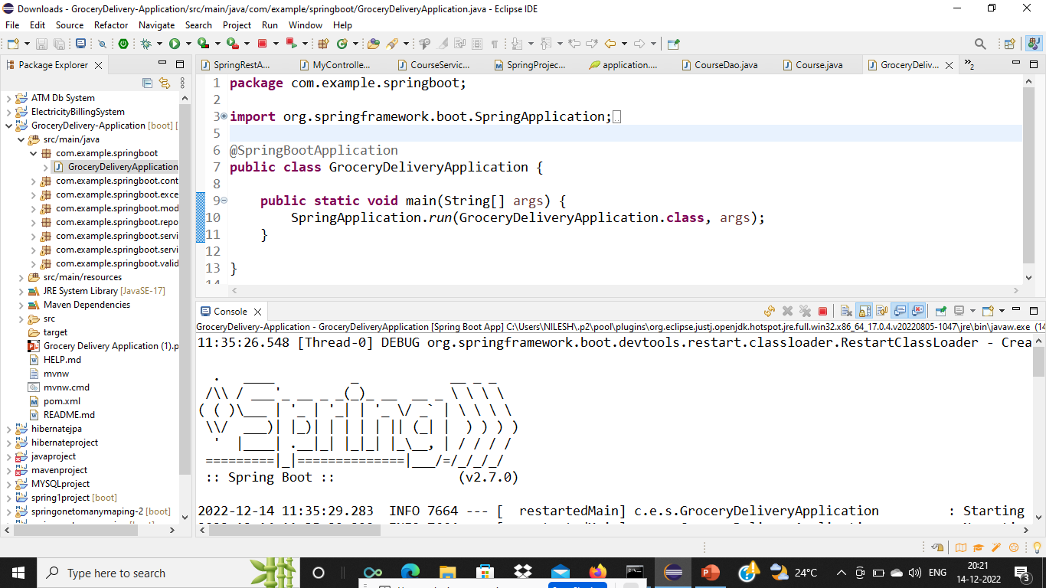
Spring Boot Application :

Slide 25
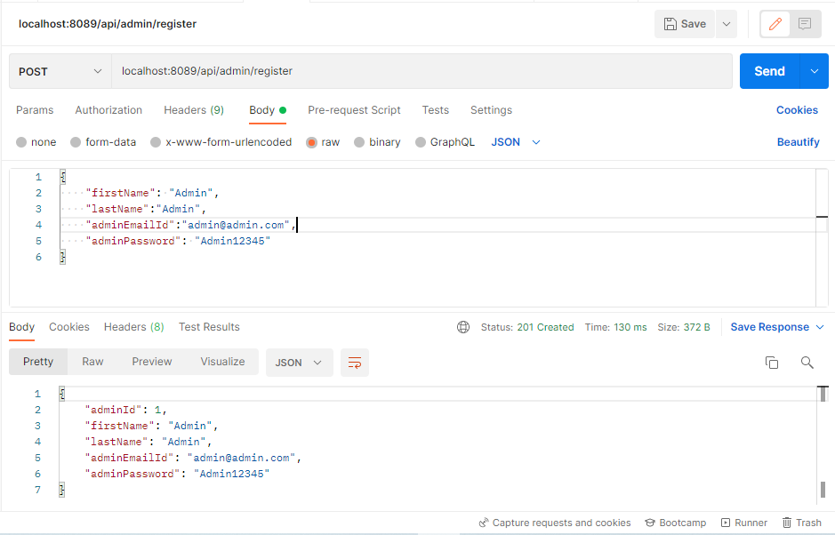

Slide 26
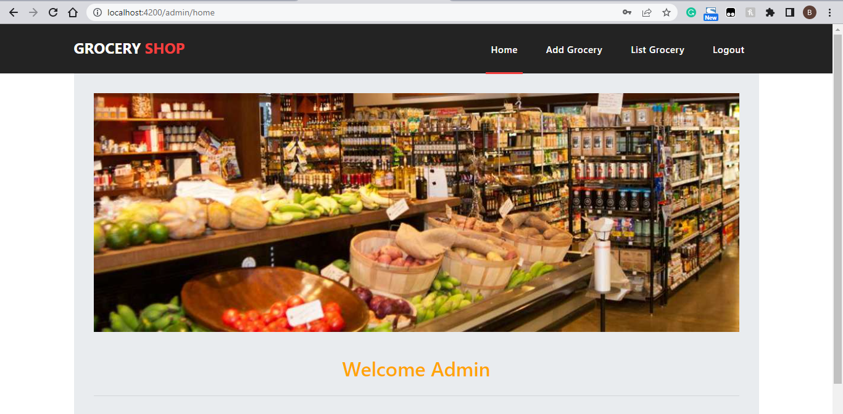
4)Admin Home Page:

Slide 27
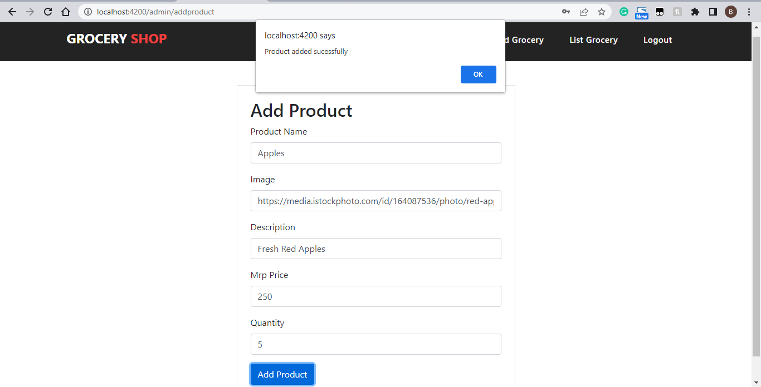
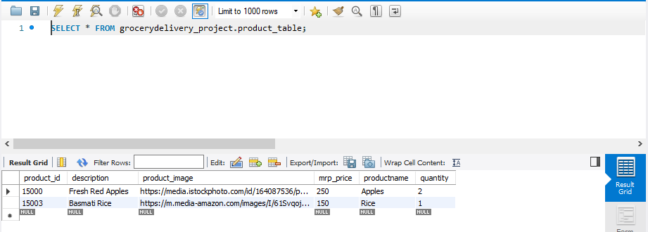
5)Admin Add Product Page:

Slide 28
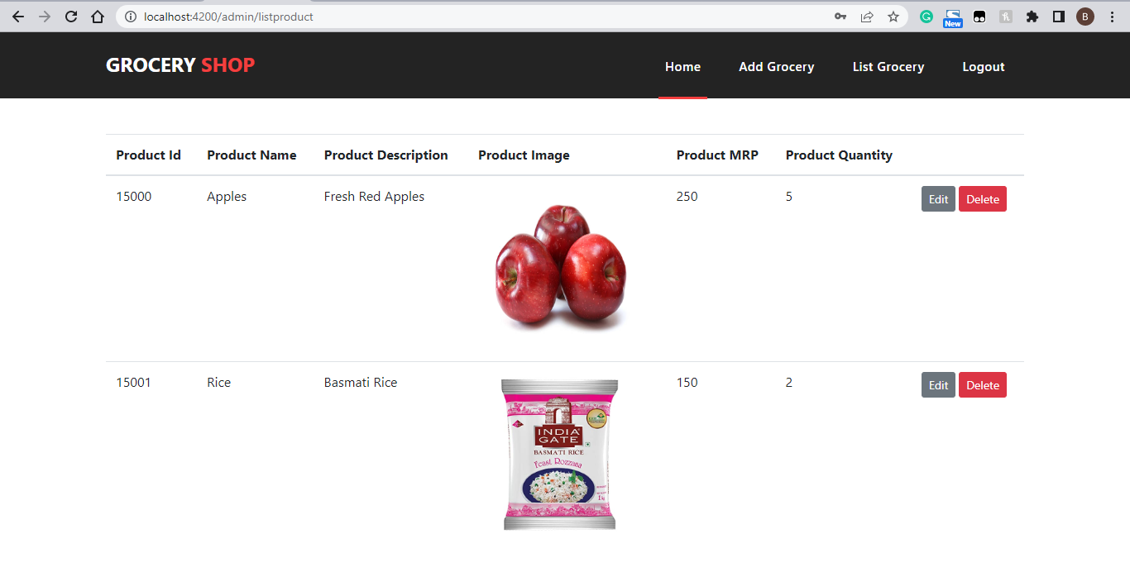
6)List Grocery Page:

Slide 29
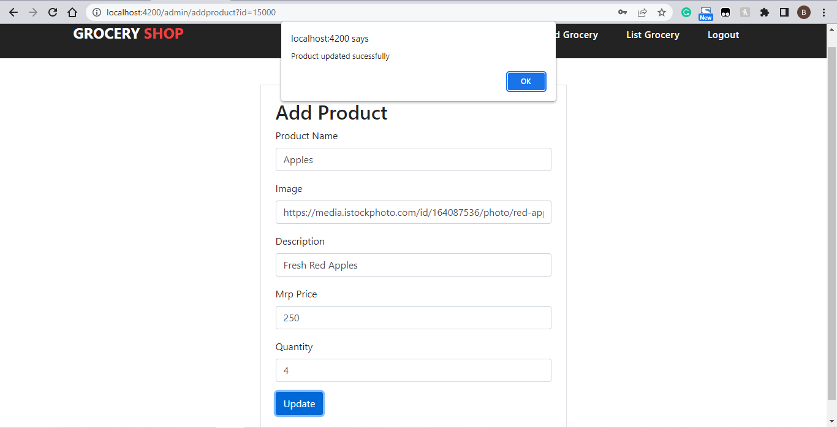
7) Update Product Page:

Slide 30
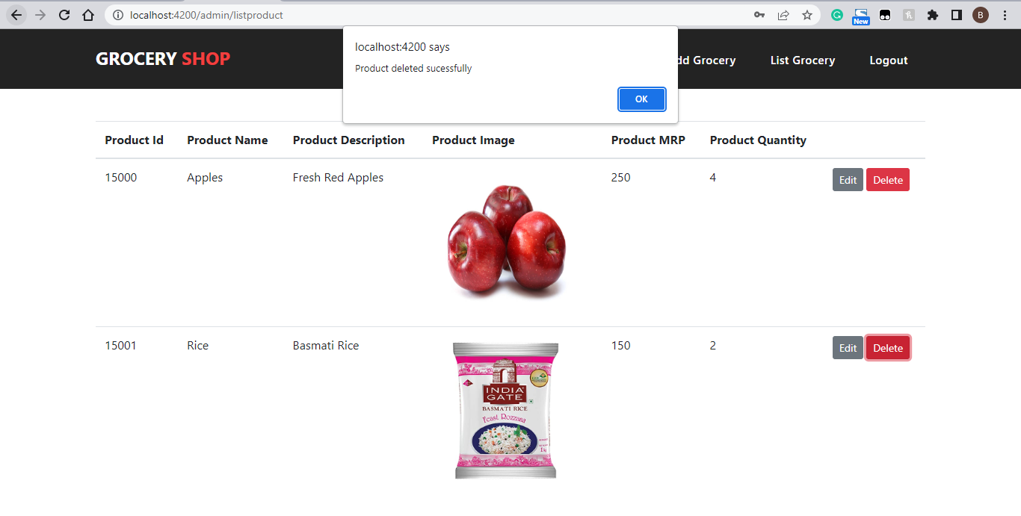
8) Delete Product Page:

Slide 31
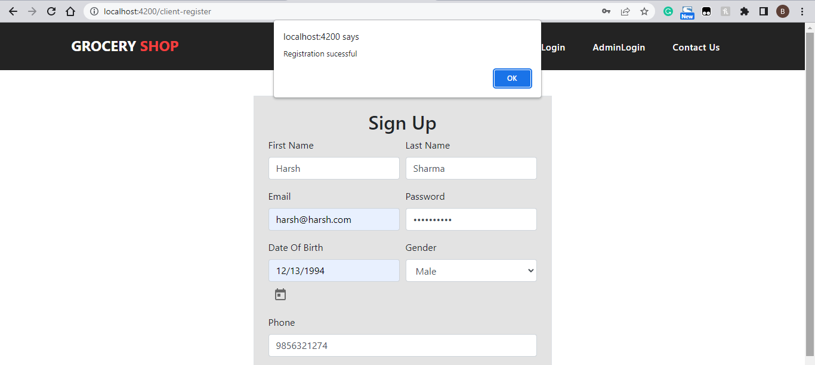

9)Sign Up Page

Slide 32
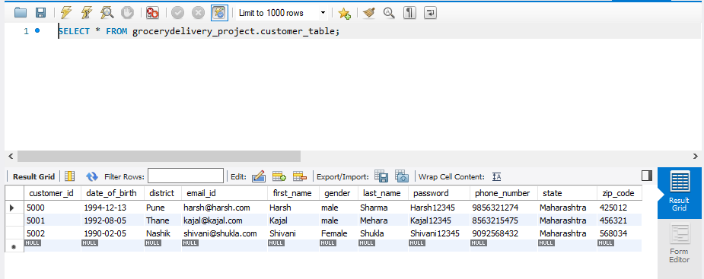

Slide 33
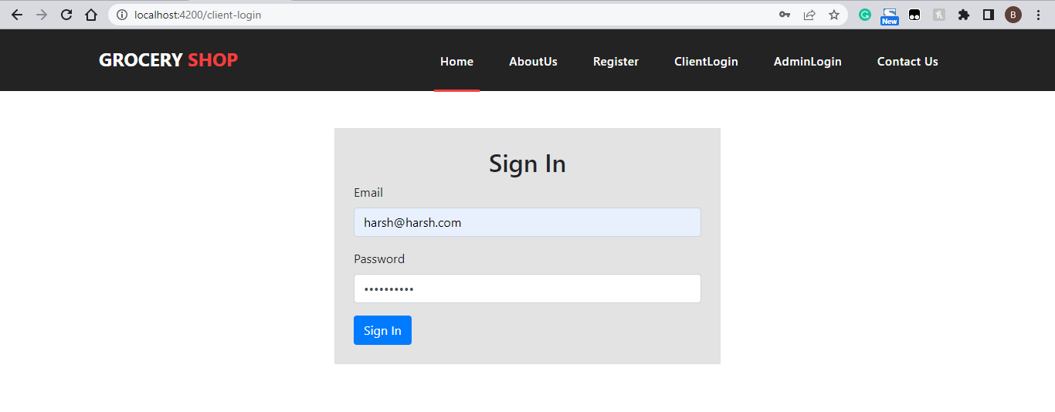
10)Customer Login Page:

Slide 34
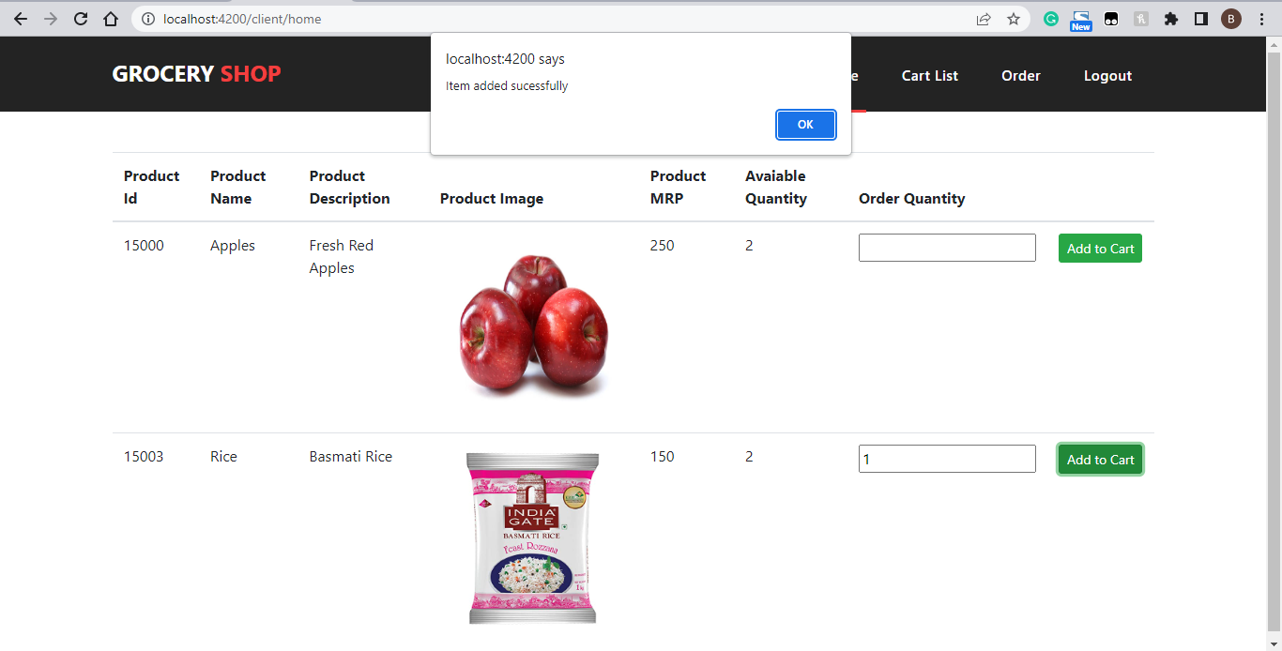
11)Add to cart page :

Slide 35
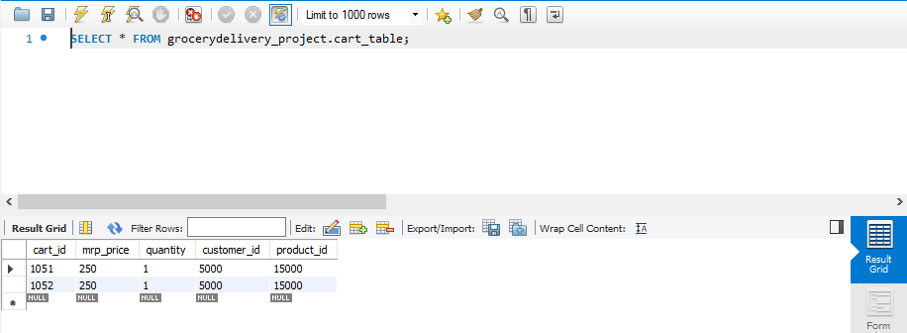

Slide 36
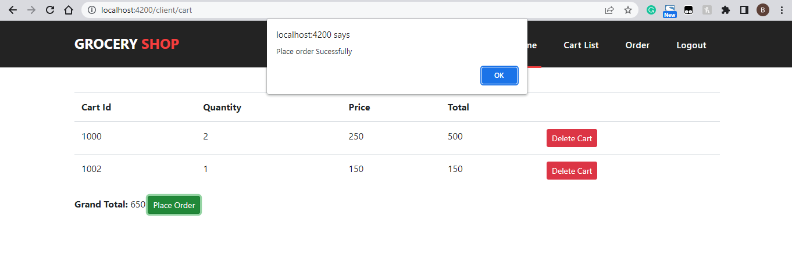
12)Cart List Page :

Slide 37
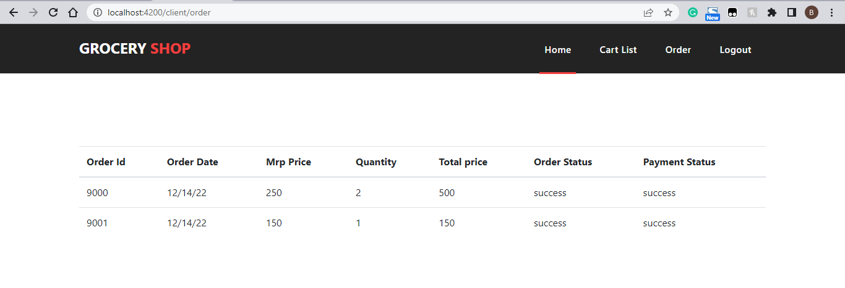
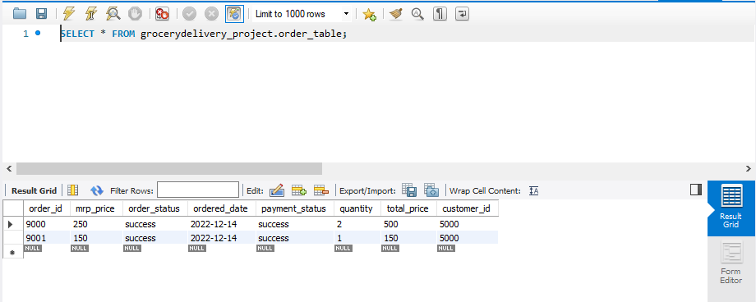
13)Order Status Page:

Slide 38
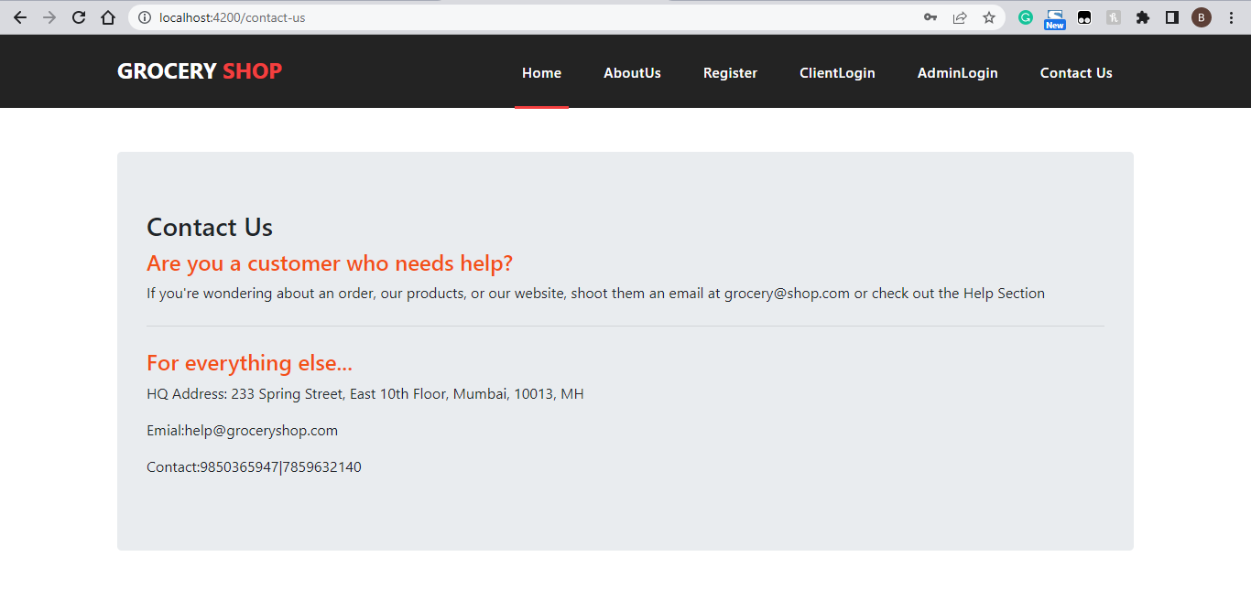
14)Contact Us Page:

Slide 39
Advantages :
1. It saves time.
2. It is far less stressful than dealing with busy grocery stores.
3. Less money is spent on gas.
4. This makes it easier to reorder items and make adjustments.
5.24*7 Availaibility.
Disadvantages :
1. It can be more expensive.
2. You cannot handpick each item.
3. You may still need to go the grocery store.

Slide 40
FUTURE ENHANCEMENT
In the next few years, we’ll see a reduced number of people in the offline stores as most of the shopping will move online.
Improved delivery methods like drones and robust logistics will further add to the future of online Grocery Delivery Services.
Solicit feedback, and customer reviews can play a vital role in improving your order on the website.
Allow customers to return the products and get their money back when grocery items didn't meet their expectations at the time of delivery.

Slide 41
CONCLUSION
Online grocery services meet a number of consumer needs including providing products for niche markets or helping the time starved consumer shop for the mundane weekly groceries. By delivering products to consumers' homes, the homebound aged and handicapped can participate in the shopping experience. Even though there has been a great decline in the number of pure-play online stores, there appears to be a solid market for shopping online.
This model is effective as it creates distribution efficiencies and leverages reputation, which is an important consideration for consumers in light of the perishable nature of many grocery products.

Slide 42
THANK YOU…!

